Slide 1


Researcher Training
Welcome!
The session will begin shortly.
General Information:
If you have a question for the presenter, please type them into the Chat Box on the GoTo Training Control Panel.
The presentation will last approximately 30 minutes followed by a 15 minute Q&A session.
The slides will be available for download after the training is over.
01.04.2017
Notes:
Welcome!

Slide 2

01.04.2017
Notes:
ResearchMatch is an NIH funded initiative that began in 2010 and was and is based on the CTSA consortium. RM is a platform that matches people interested in research with investigators and study teams in order to support and raise awareness of opportunities to be involved in research- nationwide.

Slide 3

What we will cover:
Signing up and gaining feasibility access
Registering your IRB approved study and gaining recruitment access
Searching for and contacting potential volunteers
Managing your Volunteer Continuum List
03.24.2017
Notes:
Welcome! This video covers gaining recruitment access and contacting volunteers.

Slide 4

Definitions Used Today
Researcher: person who has been given access to use ResearchMatch.org for recruitment
Institutional Liaison: person at your institution who reviews your access into the RM system
Recruitment Access: An access level that allows researchers to use RM for contacting potential volunteers. The researcher must have an IRB approved study and an IRB approved contact message.
Feasibility Access: An access level that allows researchers to search aggregate registry information only. The researcher does not need to register an IRB approved study.
Contact Message: The information a researcher sends through the RM system to potential volunteers.
Notes:
Highlight researcher – includes study staff – does not mean that it is always the PI
Two levels of access – Feasibility and Recruitment – note differences
Contact Message: The information a researcher sends through the RM system to potential volunteers – this is not the same as an email

Slide 5




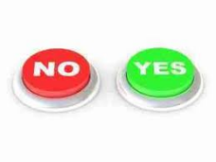
ResearchMatch is a national platform
which connects researchers with people interested in research
The researcher sends IRB approved messages via email to potential participants!
People that are interested in hearing more about a study
Release their contact information --- via ResearchMatch --- to the researcher
IRB approved
PI confirms
Liaisons confirms
Volunteers make the final choice
To share their identifiable contact
information with the researcher
Notes:
1-At ResearchMatch the protection of the volunteers’ contact
information and health data is essential.
2-RM uses a clearinghouse model that blocks identifying information on a researcher’s screen until the volunteer specifically gives approval to be contacted for a specific study.
3-*Even after receiving such approval, researchers using ResearchMatch must agree to treat all identifying information as confidential and use it for only the study which is registered.
Show slide
A volunteer has no obligation to ever say yes to an email message.
So, how does it work?
ResearchMatch volunteers who have registered with ResearchMatch are connected with researchers who are conducting studies that may ‘match’ with the volunteer's background.
First, researchers register themselves and their IRB approved study on RM. The liaison reviews the application and approves it. Then the researchers can come onto RM, look at the de-identified information about the volunteers, and choose a group of volunteers that seem to be a good match for their study. They then submit an IRB approved ‘contact message’ that the RM system sends out to volunteers by email. The volunteer receives an email that contains the study information. The volunteer then has the option of accepting or denying that request to learn more about the researchers study. If they say yes they want to learn more, then their contact information is released to the researcher.

Slide 6
Process of Recruitment Access for Researchers
Researcher Creates Researcher Account and Registers IRB Approved Study
PI Approves Researcher with 2-step process
Study is sent to Liaison Dashboard
Approve Request
Deny Request
Researcher Self-Validates with 2-step process
Researcher Corrects and Resubmits
Recruitment Access Granted
END GOAL IS TO GRANT RECRUITMENT ACCESS
Notes:
This flowchart is to help you visualize the process to approve a researcher for recruitment access.

Slide 7
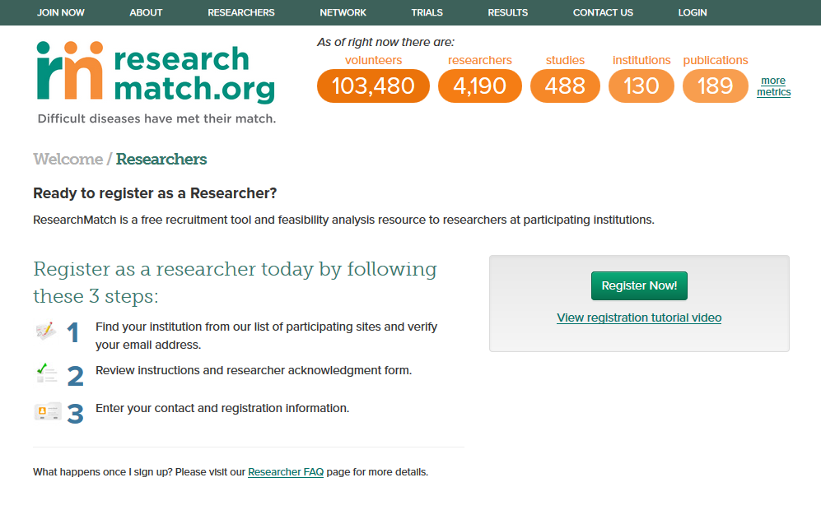
Getting Started- Register
Click Researcher Tab at top of RM website page.
Notes:
To sign up and gain feasibility access start by watching the registration tutorial video and then hit Register Now

Slide 8
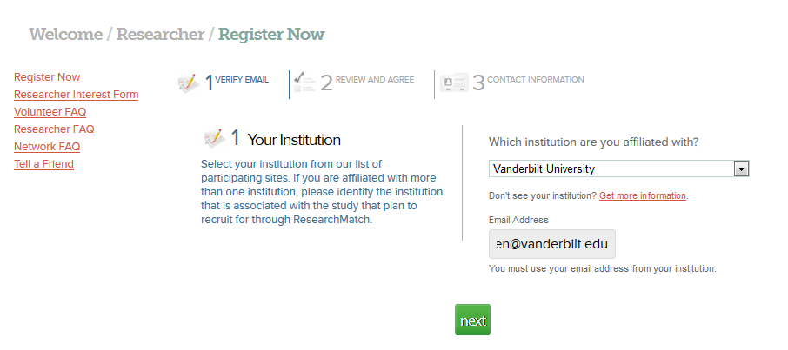
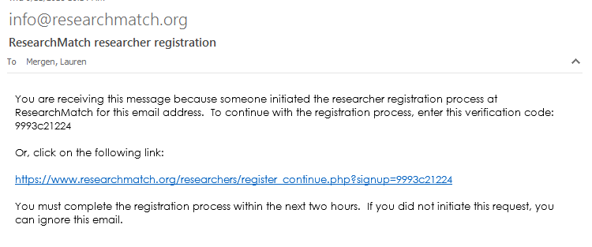

Notes:
SELECT YOUR INSTITUTION AND ENTER EMAIL – NEXT
YOU WILL GET AN EMAIL WITH VERIFICATION CODE

Slide 9
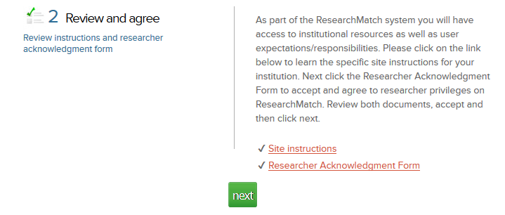
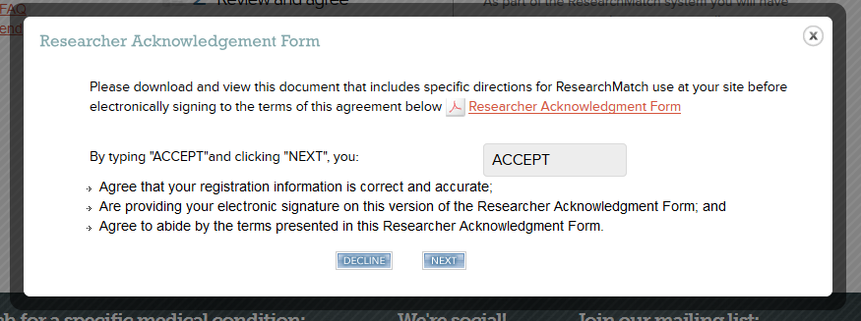
Notes:
REVIEW SITE INSTRUCTIONS AND RESEARCHER ACKNOLEDGMENT FORM AND ACCEPT - NEXT

Slide 10
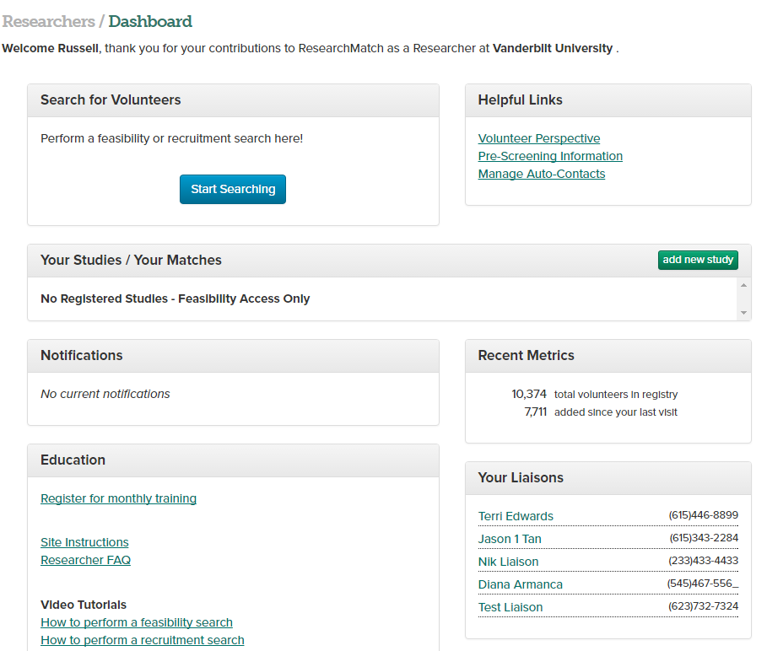
Notes:
If you are a PI or part of a study team at one of the network institutions you may gain feasibility access today. With feasibility access, you are able to search for aggregate registry data, but you will not be able to contact volunteers or see volunteer-specific health data. You may perform feasibility searches of the database for your current study or future studies. This is a good way to learn how to apply the RM filters and assemble a cohort of potential matches.

Slide 11
How to Register your IRB Approved Study
03.24.2017
Notes:
ResearchMatch is an NIH funded initiative that began in 2010 and was and is based on the CTSA consortium. RM is a platform that matches people interested in research with investigators and study teams in order to support and raise awareness of opportunities to be involved in research- nationwide.

Slide 12
On your dashboard– you can click
“add new study”
when you have IRB approval for recruitment and are ready to upload the current IRB approval letter.
IF you are KSP add yourself to an existing study
Notes:
From your dashboard, in order to gain recruitment access, you’ll need to click ‘add new study’ when you have IRB approval for recruitment and are ready to upload the current IRB approval letter.

Slide 13
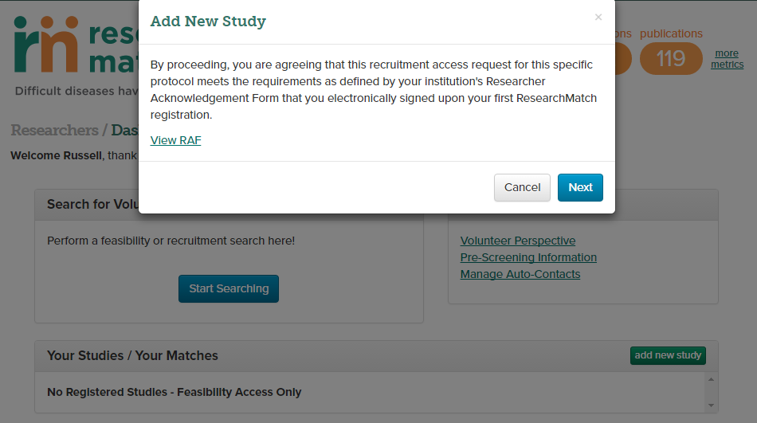
Notes:
When you click ‘add a new study; you will be asked to agree that this request meets the requirements defined by your institution’s Researcher Acknowledgement Form that you signed upon your registration for researcher access to RM. CLICK NEXT

Slide 14

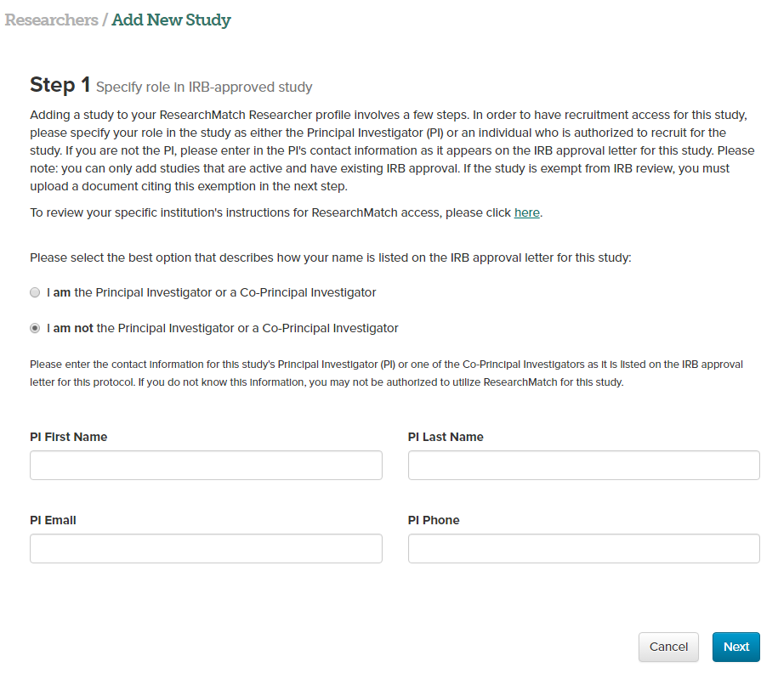
Adding a New Study
01.04.2017
Notes:
It is important to have an IRB approved protocol, and an IRB approved contact message for use on ResearchMatch before beginning the process.
Here, you will specify your role as either the principal investigator (PI) or as a proxy researcher. If you are not the PI on the study, you will be asked to enter the PI’s contact information. Then, your PI must approve you + you cannot approve yourself.

Slide 15
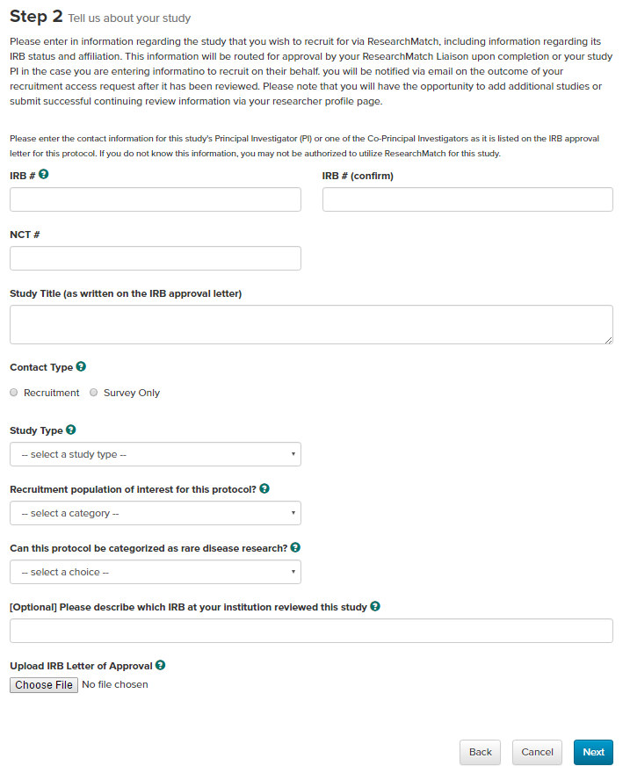
Notes:
ENTER your IRB #, National Clinical Trials # if you have one, the STUDY TITLE and ADDITIONAL STUDY INFO

Slide 16
Researcher must select Recruitment or Survey. Recruitment is for studies that will require the Volunteer to complete study visits. Survey is for studies that will only involve collection of data through a electronic survey instrument.
Notes:
Researcher must select Recruitment or Survey. Recruitment is for studies that will require the Volunteer to complete study visits. Survey is for studies that will only involve collection of data through a electronic survey instrument.
If you have an interventional study and select recruitment, you will have the opportunity to enter a REDCap pre-screening survey later in the contact process

Slide 17
You may upload only one document. If your site requires multiple documents, you will need to merge into a single file before uploading.
Notes:
Next, you will upload your Final Approval Letter from your local or central IRB. This is the letter you or your PI received which includes expiration dates for the study. You may upload only one document so please merge documents if you have central and local IRB approvals.
if you have any questions while registering your study.- your site specific instructions are available in 2 locations:
within the “requirements” hyperlink next to UPLOAD IRB LETTER and on the menu tab on the left side.
You may upload only one document. If your site required multiple documents, you will need to merge into a single file before uploading

Slide 18
REMEMBER:
Your IRB letter must be a current letter from the IRB of record, that clearly indicates:
The IRB number of this study
The IRB expiration date of this study
Study title
Evidence that this study has been approved
First and last name of the PI
Notes:
REMEMBER: your IRB letter must be a current letter that clearly indicates:
The IRB number of this study
The IRB expiration date of this study
Study title
Evidence that this study has been approved
First and last name of the PI

Slide 19
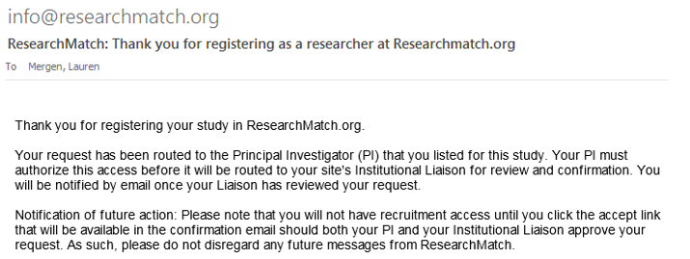
After you have finished adding your study, you will receive a confirmation email.
Notes:
THEN- CHECK YOUR EMAIL: you will get an email outlining the status of your study - it’s on it’s way to your PI for approval!

Slide 20
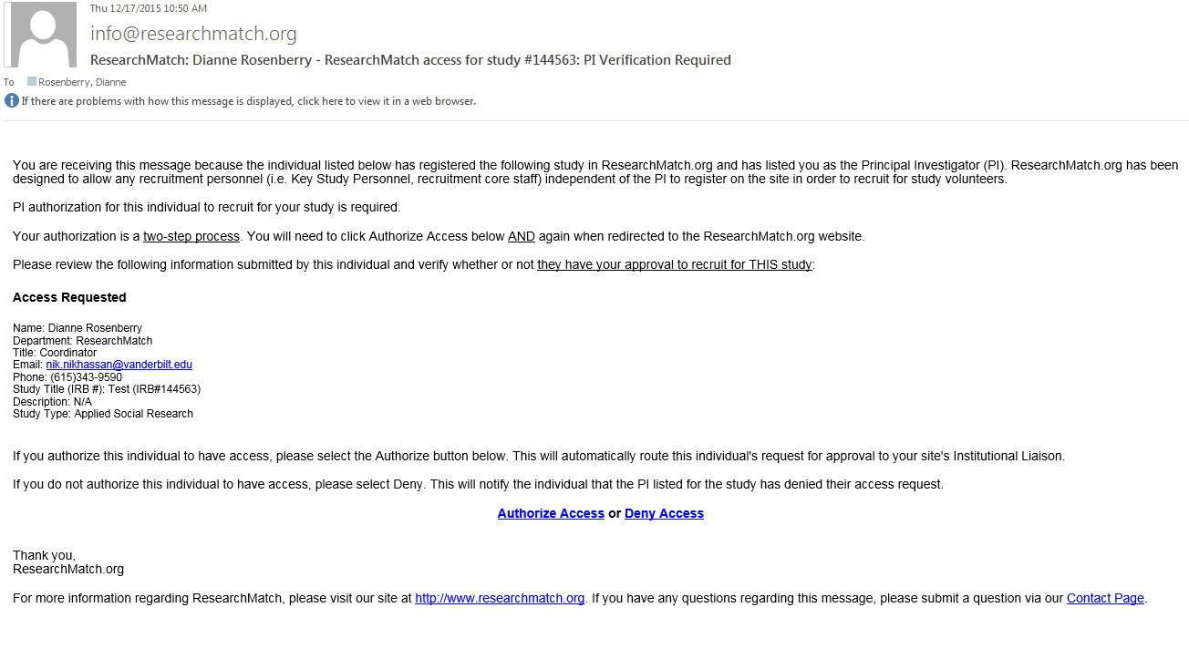
PI receives an email to allow the proxy researcher access.
PI must click AUTHORIZE ACCESS in the body of the email rather than responding to email.
This is a two step process! Clicking AUTHORIZE ACCESS will bring the PI to RM site where they will click “yes” to authorize access for the final step. The PI does not need to login.
Notes:
THE PI receives an email and must authorize your access for the study that was registered.
Please note that the PI can not reply to the email. They have to participate in the 2-step process to approve the researcher.

Slide 21
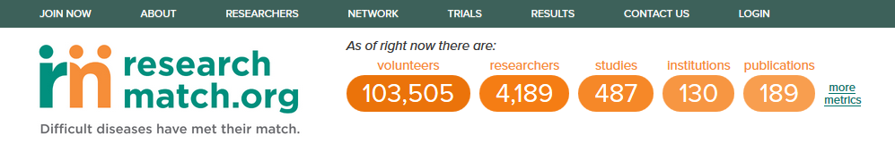
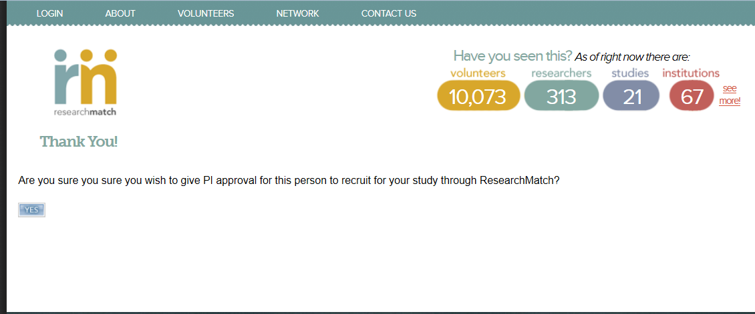
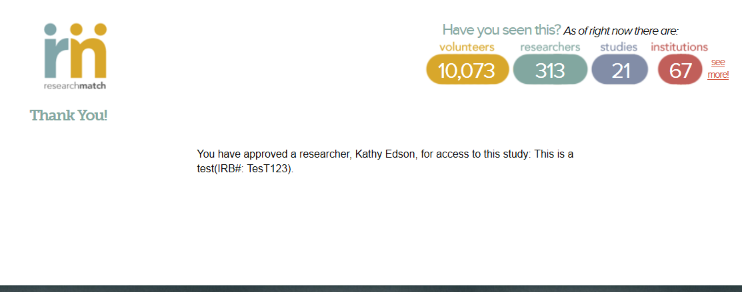
PI clicks yes
After PI clicks yes the researcher that was approved appears with the corresponding IRB#:
Notes:
The PI clicks the link in the email and then one more time on the rm page then they are good to go!

Slide 22
Once your liaison confirms your recruitment access request,
you will get an email to self-validate.
Until you act upon this request, you will not have recruitment access for
this study (again, this is a two-step process)
Notes:
Read slide

Slide 23
Process of Recruitment Access for Researchers
Researcher Creates Researcher Account and Registers IRB Approved Study
PI Approves Researcher with 2-step process
Study is sent to Liaison Dashboard
Approve Request
Deny Request
Researcher Self-Validates with 2-step process
Researcher Corrects and Resubmits
Recruitment Access Granted
END GOAL IS TO GRANT RECRUITMENT ACCESS
Notes:
After this, you will have the ability to send contact messages to volunteers in the researchmatch databse, otherwise called ‘recruitment access’

Slide 24
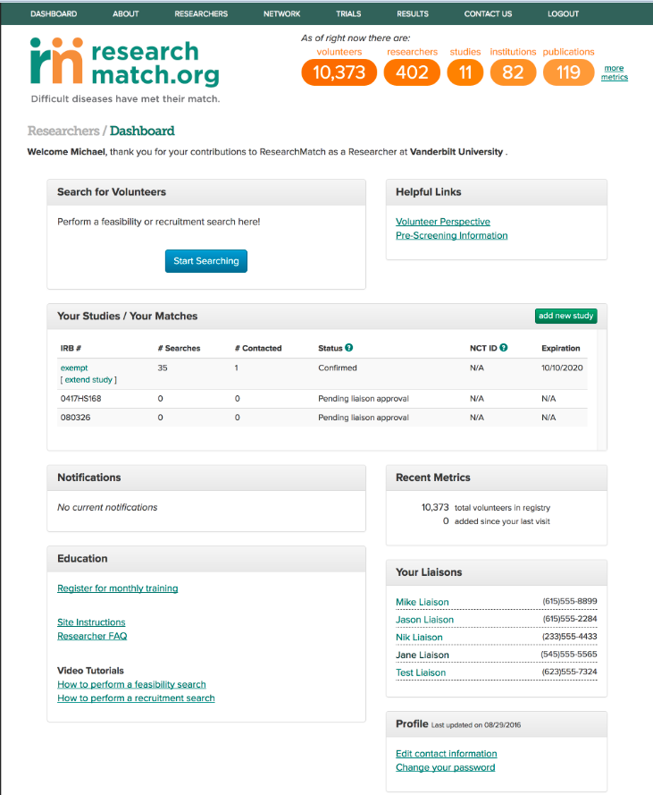
Notes:
This is the researcher dashboard. (click) You can search for volunteers,(click) see the statuses of your studies (click) and contact your institutional liaisons

Slide 25
How to Perform a Search for Volunteers
Notes:
SWITCH TO LB

Slide 26
Notes:
Click ‘start searching’ to begin searching for volunteers

Slide 27
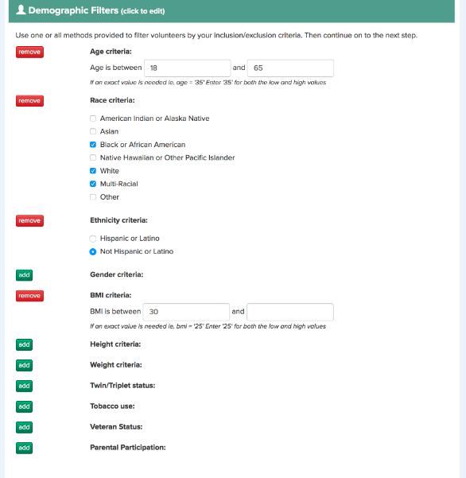
111,000
20,000
7,000
800
58
Notes:
You can use as many or as few filters as appropriate to define your cohort. As you apply more filters, you will notice the number of total volunteers found after filters applied will decrease. So, if you begin with no filters, you will see all volunteers in the ResearchMatch database. By adding filters, you can refine that number to a set of volunteers that fit the specific eligibility criteria of your study. Once you have applied all necessary filters, you will click “select volunteers’ at the bottom of the page.

Slide 28
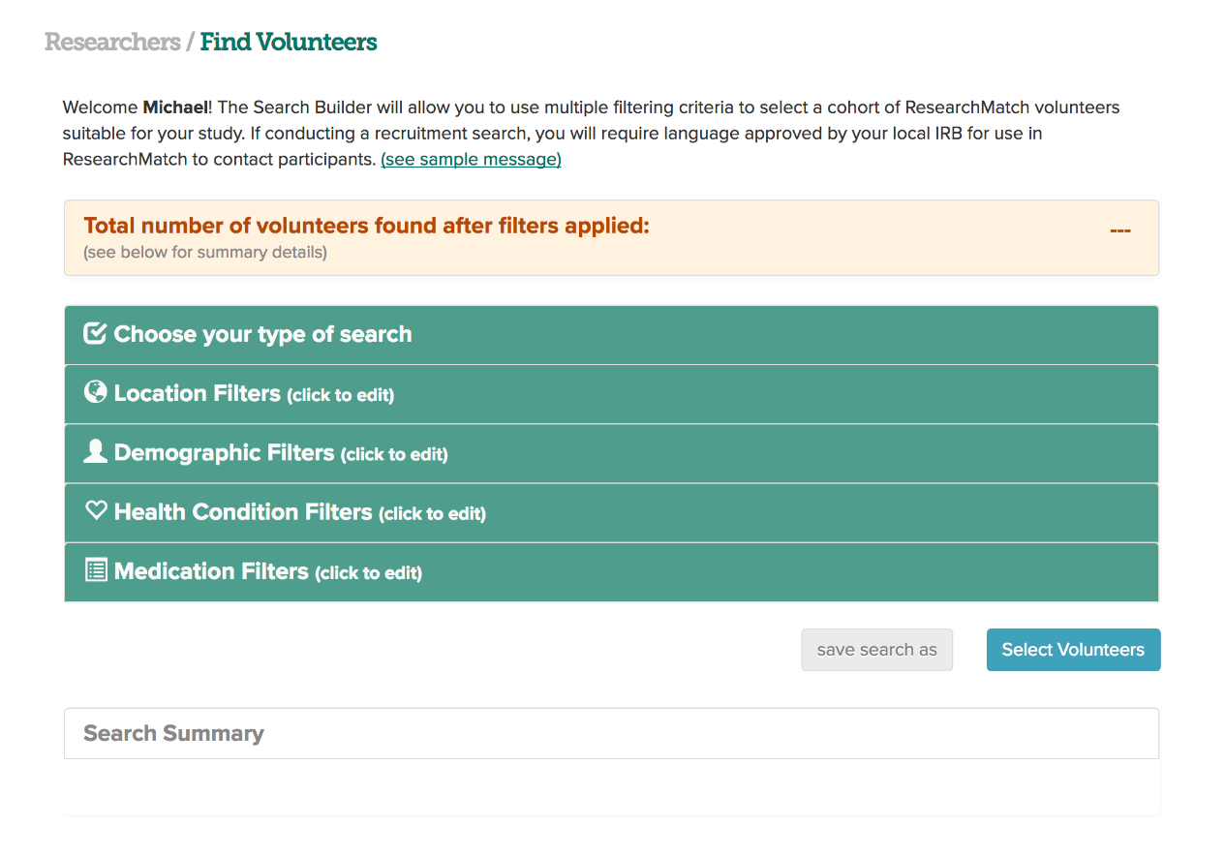
Note: When performing a feasibility search, data is rounded to the nearest 10. If you yield a count of 10, this means that 1-10 RM volunteers match your search criteria. If there are no matches, search will yield a count of 0.
Notes:
There are several steps, or filtering sections, to build a search. The filters act like a drop down menu. You can use these filters to refine your cohort. (click) As you add each filter, ResearchMatch will update the number of volunteers who meet the filter criteria.
(click)
Note: When performing a feasibility search, data is rounded to the nearest 10. If you yield a count of 10, this means that 1-10 RM volunteers match your search criteria. If there are no matches, search will yield a count of 0.

Slide 29
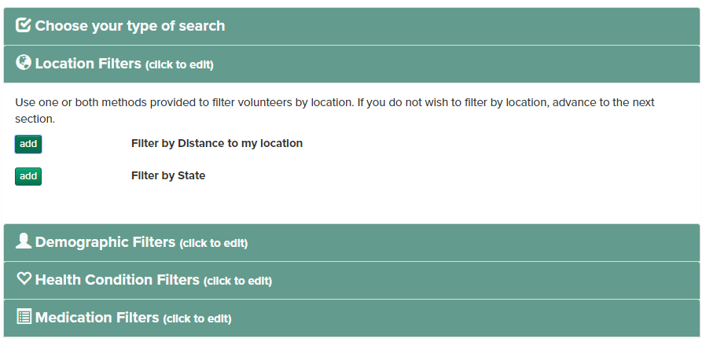
Notes:
After selecting the type of search, either recruitment or feasibility, we can move through the filters to refine our cohort. Let’s say that we only want to include volunteers who live less than 50 miles from our location.

Slide 30
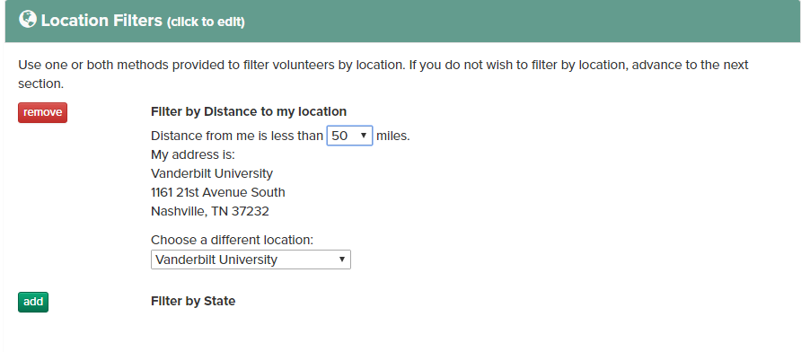
Notes:
ResearchMatch auto populates your address based on the institution. If your institution has multiple locations, you should see these in the drop down menu. You can use as many location filters as you would like.

Slide 31
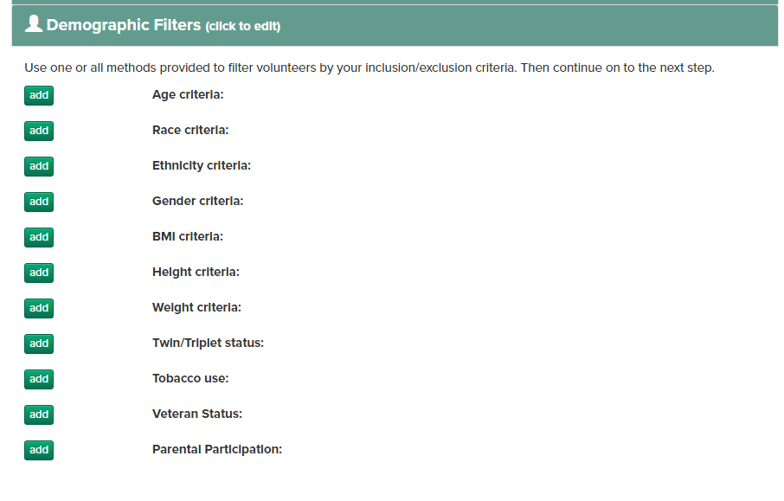
Notes:
In the next section, you can filter by a number of demographic filters. Let’s say we want to include volunteers ages 18 to 55. Click the ‘add’ button next to age criteria (click)

Slide 32
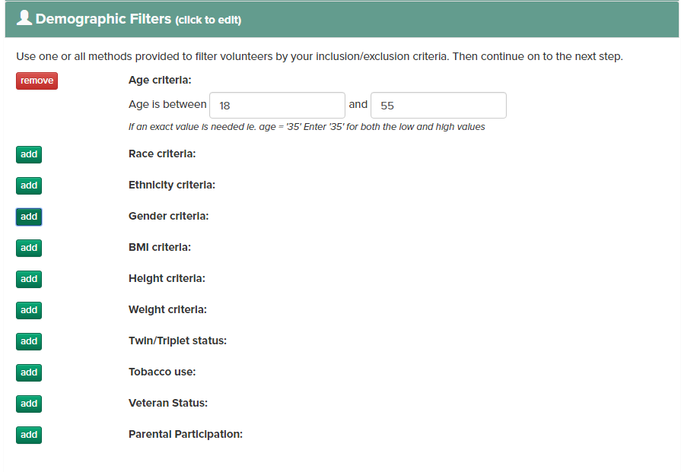
Notes:
And then enter the age range we would like to include. You may use as many of as few filters as you would like. If you have multiple populations, like ages 18-20 AND 50-55, it may be helpful to perform separate, repeated searches.

Slide 33
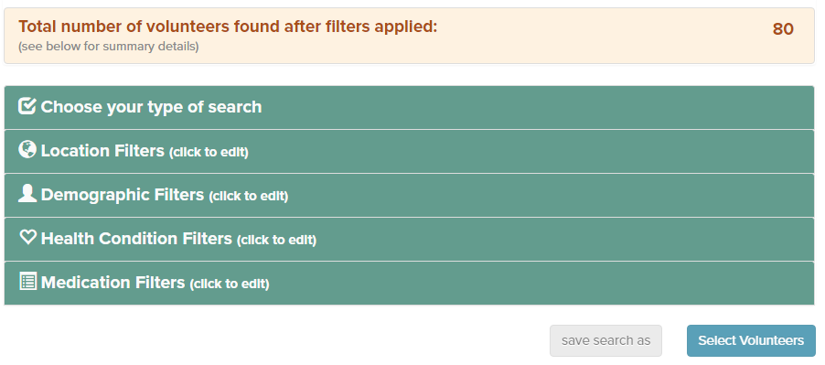
Notes:
As you can see, the total number of volunteers found has decreased to around 80. This tab is always visible as you scroll through the filters so that you have an idea of how your searches are affecting the number of volunteers fitting the criteria.

Slide 34
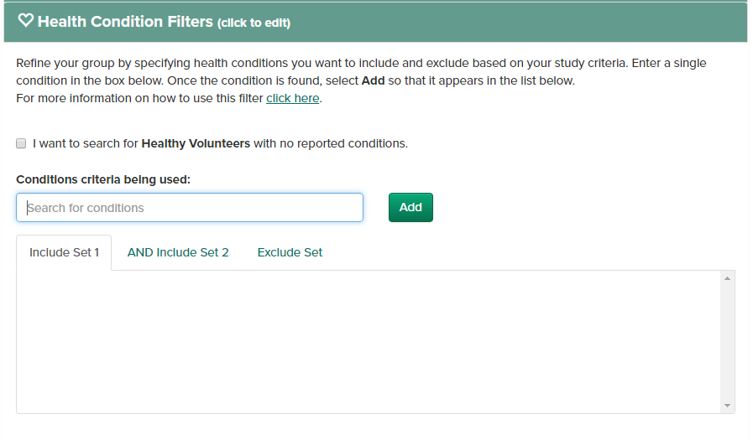
Notes:
Let’s move on to the health condition filter. Click here (click) to read the instructions.

Slide 35
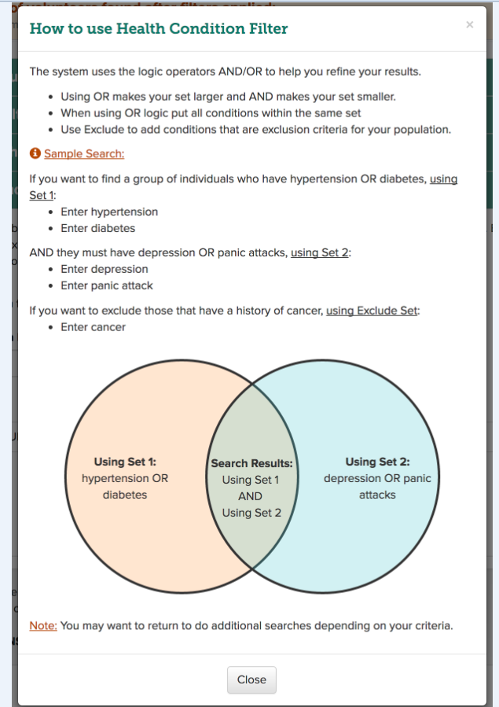
Notes:
The health and medication filters make use of Boolean logic, using AND/OR to help you refine your results. Using OR makes your set larger and AND makes your set smaller.

Slide 36
Notes:
In our case, we want to include individuals with high blood pressure, while EXCLUDING volunteers with coronary artery disease.

Slide 37
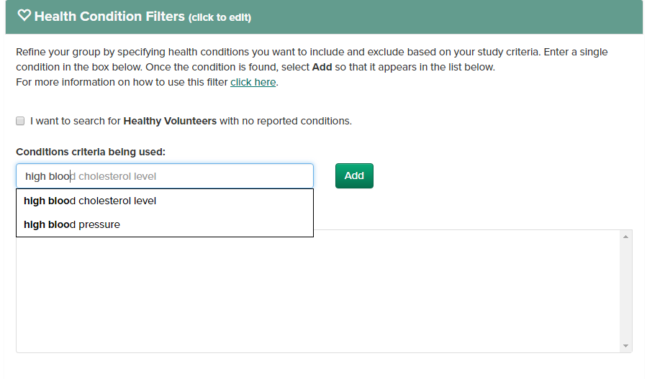
Notes:
To do this, I will enter high blood pressure in to the include set 1

Slide 38
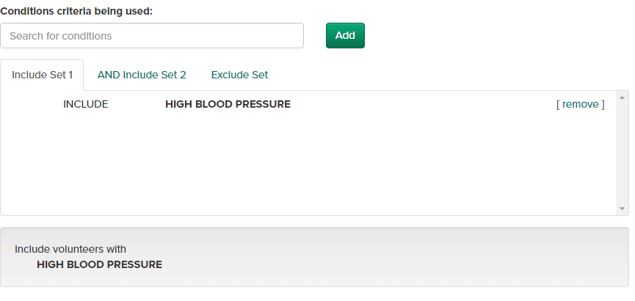
Notes:
As you can see, this search will include volunteers with high blood pressure. This section will update as you add more inclusion and exclusion criteria.

Slide 39
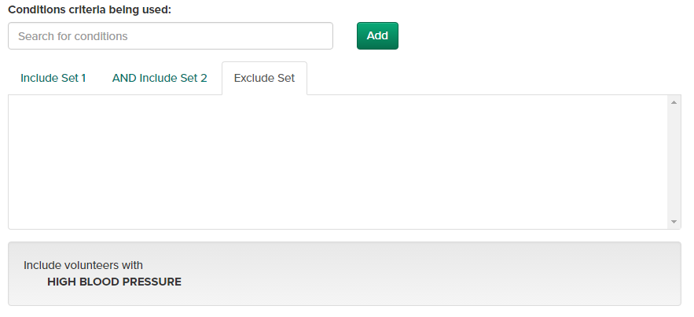
Notes:
Now, if we want to exclude individuals with coronary artery disease, we first need to click on the ‘exclude set’ tab.

Slide 40
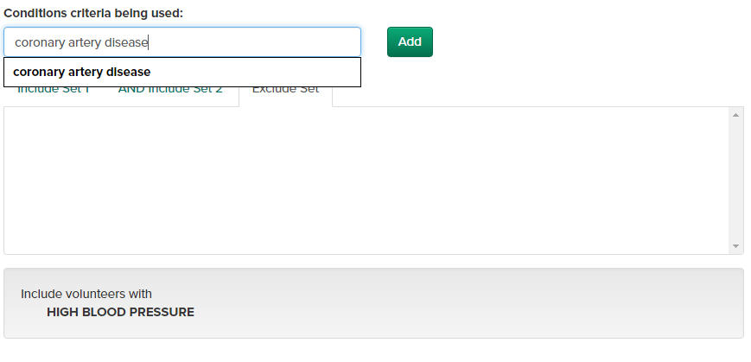
Notes:
Type in the condition

Slide 41
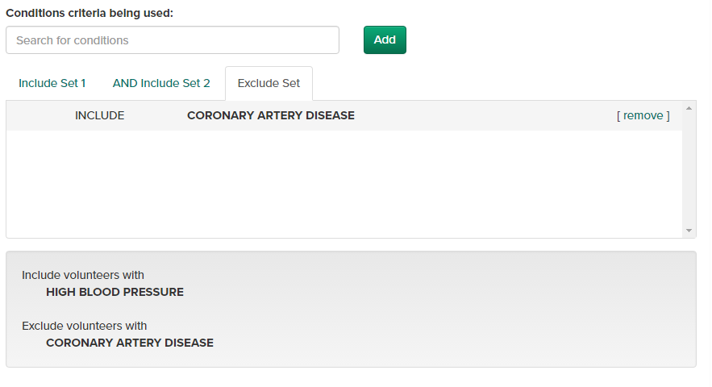
Notes:
And click add. As you can see, we are now including volunteers with high blood pressure and excluding volunteers with coronary artery disease. It’s a good idea to check this box before moving forward to ensure that you have entered everything correctly.
The medication filters work in the same way and since we don’t need to add any medication criteria, we will move on.

Slide 42
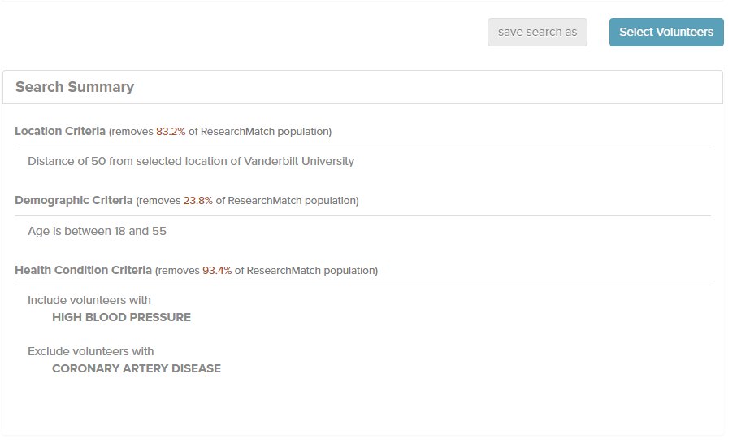
Notes:
At the bottom of the page, beneath the ‘save search’ and contact volunteers’ buttons, you will see a summary of the search. This is a good way to verify that everything is correct before moving on to the select volunteers section. You can also see how each search affected the number of volunteers meeting the criteria. In our case, the location criteria removed a significant portion of the ResearchMatch population.
To move on to contacting volunteers, we will click ‘select volunteers’. Here, you also have the option to save your search.

Slide 43
Selecting and Contacting Volunteers
Notes:
SWITCH BACK FROM LB

Slide 44
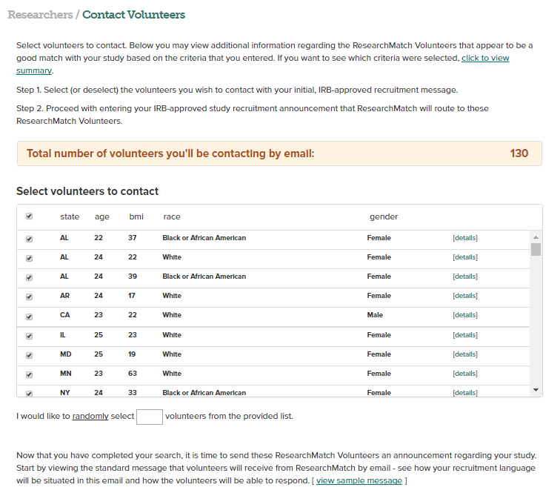
What happens before selecting volunteers to contact!
View anonymous demographic information: Age, BMI, conditions, medications
Check who you would like to message
Notes:
After clicking ‘select volunteers’, you will see a list of all volunteers that you may want to contact.
You still only have anonymous information. BUT if you click on DETAILS you will see some health information and demographic information.

Slide 45
What happens before selecting volunteers to contact!
If your search results in more than 1,500 volunteers, you will be forced to manually or automatically select a number below 1,500 to contact.
Notes:
Read the screen. If you have more than 1,500 volunteers that you wish to contact, you can use the saved search feature to perform a repeated search and contact volunteers in batches. Don’t worry about contacting the same volunteer twice – the system won’t allow you to do this.

Slide 46
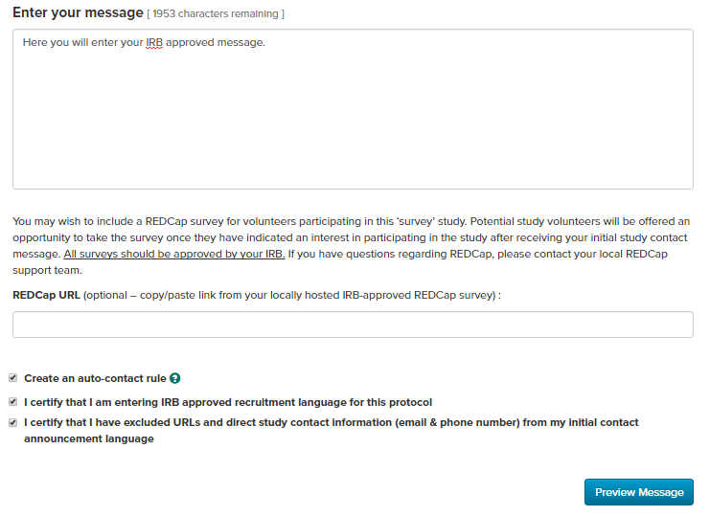

Only IRB approved contact message here. This means no direct contact information or urls
Notes:
After you’ve selected who you’d like to contact, prepare your contact message. You should enter only IRB approved contact language, meaning that your message will not include direct contact information or urls
If you are using a pre-screening survey, you can enter it here. The volunteer does not see the prescreening survey in the contact message. They are only re-directed to it, if they tell us YES.
Finally, you must certify that you’re entering only IRB-approved language and not including URLS/contact info and preview before sending. If you try to check these boxes before entering your message, the ‘preview message’ button will not activate.

Slide 47
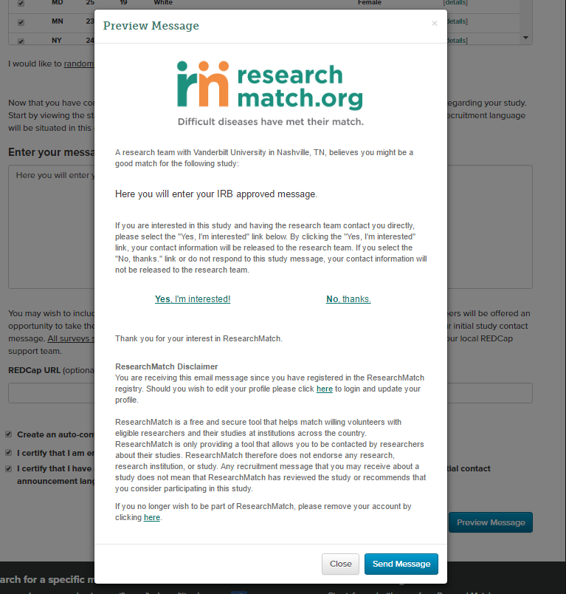
Notes:
After clicking the ‘preview message’ button, you will see a sample of what the volunteer will receive in their inbox. If the volunteer clicks ‘yes, I’m interested’, their contact information will appear in your volunteer continuum. If they do not reply or click ‘no thanks’, their contact information will not be visible to you.

Slide 48
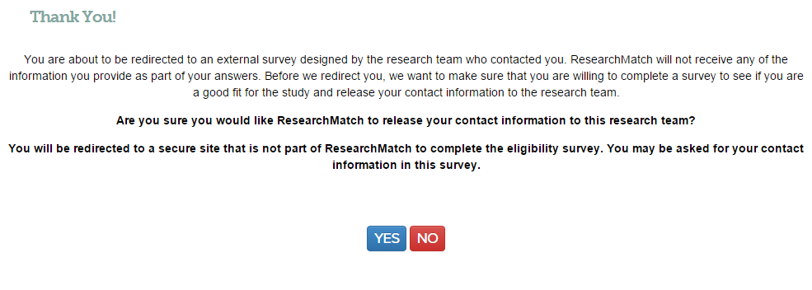


Notes:
If you have a REDCap pre-screening survey -
After a volunteer views a contact message and tells ResearchMatch “YES” release my contact information to the researcher,
they are presented with this screen.
They are informed that if they confirm ‘YES” again, ResearchMatch will RE-DIRECT them to the Researcher's survey.
As always the volunteer’s contact Information is released to the researcher and they are entered in the continuum as ‘in process’.

Slide 49
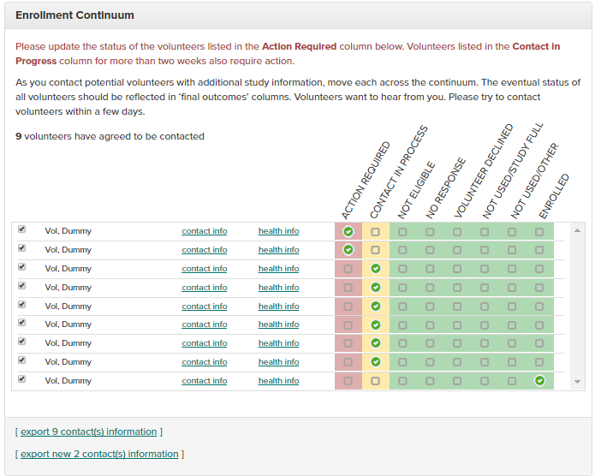
Recruitment studies
Notes:
This is the enrollment continuum. This is for a recruitment study. The survey study continuum looks slightly different.
(click)
Once Volunteers respond to your contact message they appear identified on your enrollment continuum. NOW you will see their contact information and be able to contact them directly about your study! Be sure to move them along the continuum once you have contacted them again.
(hover over health info / contact info) this is the same health info you saw before, but when you click contact info, you will be able to see actual contact info
(click)
You can export your contacts here.
If you export the contacts, you will be able to see phone numbers – you’ll be able to see more information in the export than you will be able to see by simply clicking contact info.
You also have the option to export the contact information of only new volunteers.

Slide 50
Notes:
Volunteers are ordered according to action required and color coded (red for new volunteers, yellow for contact in process, and green for final outcome).
Volunteers are listed in the order of their color class and then listed alphabetically within each category for easier scrolling.

Slide 51
Notes:
You have 2 DAYS to move volunteers from the red column – action required – to the yellow column – contact in process
Then, you have 14 DAYS to move the volunteer from yellow to green – a final outcome.

Slide 52
When a researcher moves a volunteer into a FINAL OUTCOME:
Not Eligible, Not Used/Study Full, or Not Used/Other an automated email will be sent to the Volunteer letting them know they are no longer under consideration for the study.
Notes:
What happens when moved into a FINAL OUTCOME category?
When a researcher moves a volunteer into a FINAL OUTCOME:
Not Eligible, Not Used/Study Full, or Not Used/Other an automated email will be sent to the Volunteer letting them know they are no longer under consideration for the study.

Slide 53

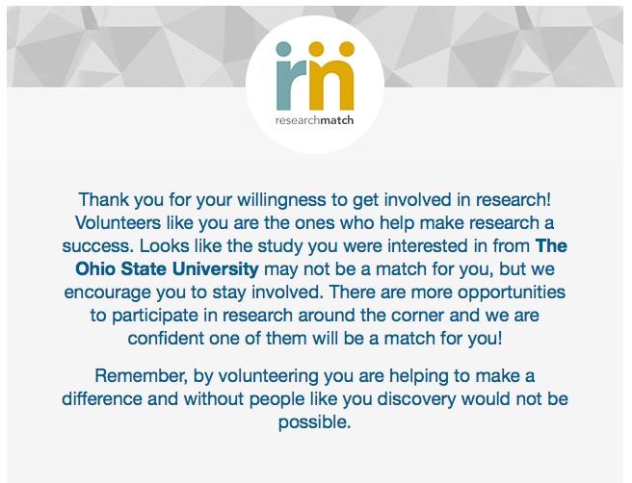
Message for “Not Eligible” Volunteers
Notes:
This is an example of what that message looks like…

Slide 54
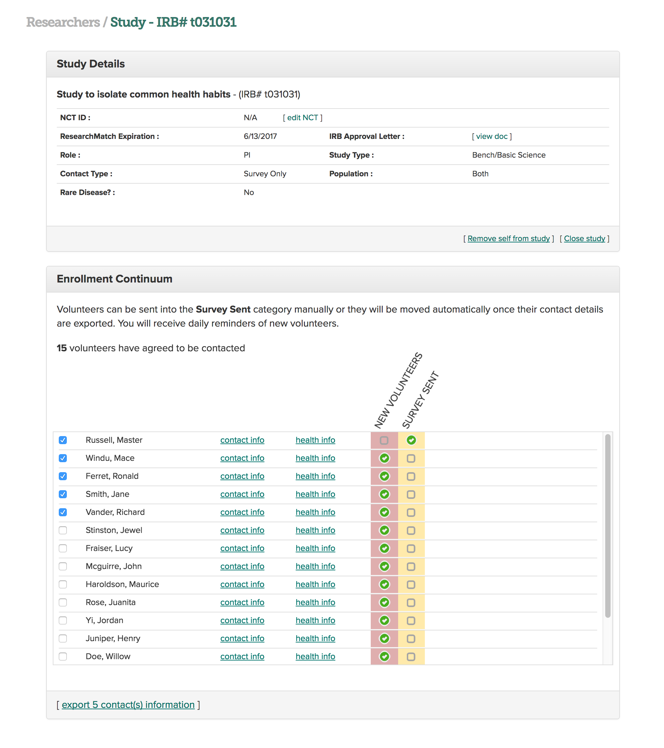
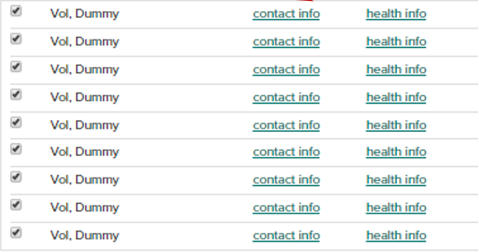
For SURVEY STUDIES
Notes:
If your study was a survey only study, this is what the survey continuum looks like. Volunteers can be sent to the SURVEY SENT category manually or they will be moved automatically once RM sends them to your survey, or their contact details have been exported.

Slide 55
Notes:
On this page on the dashboard you will also see details about the study, a link to remove yourself, or Close the study. Important note: If a researcher closes a study IT CAN NOT BE REOPENED AND THEY WILL LOSE ACCESS TO ALL INFORMAITON. PLEASE DON’T SUGGEST THAT A STUDY BE CLOSED. IT CAN EXPIRE or It can be disabled.

Slide 56
ResearchMatch Trials Today Search Tool
03.24.2017
Notes:
Before we end, I would like to briefly mention a feature on researchmatch.

Slide 57
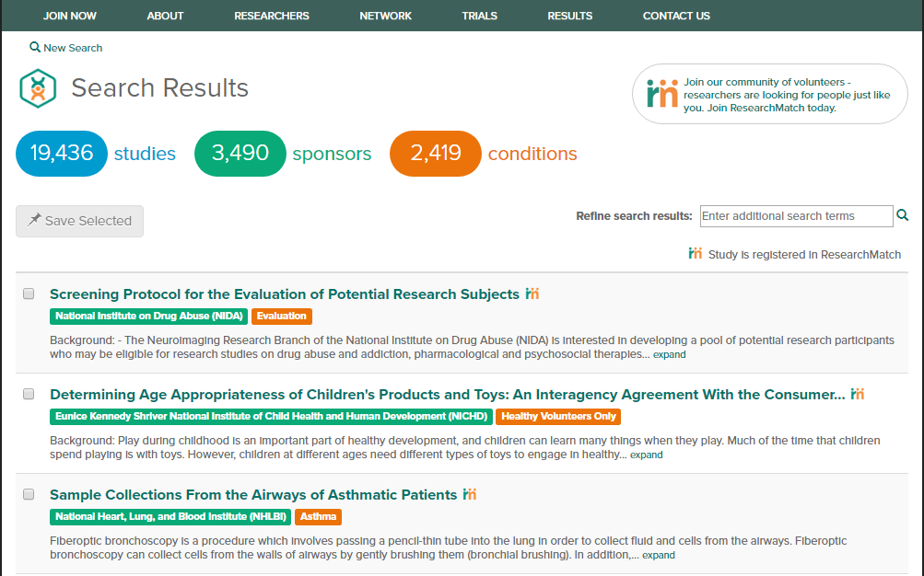
Notes:
The Trials Today search tool may be found by clicking on “trials” in the navigation bar. Here, potential volunteers may search for actively recruiting studies. The studies listed are pulled from clinicaltrials.gov. If a volunteer is interested in learning more about a study, they may click on the study name to view a more detailed description and eligibility criteria.

Slide 58
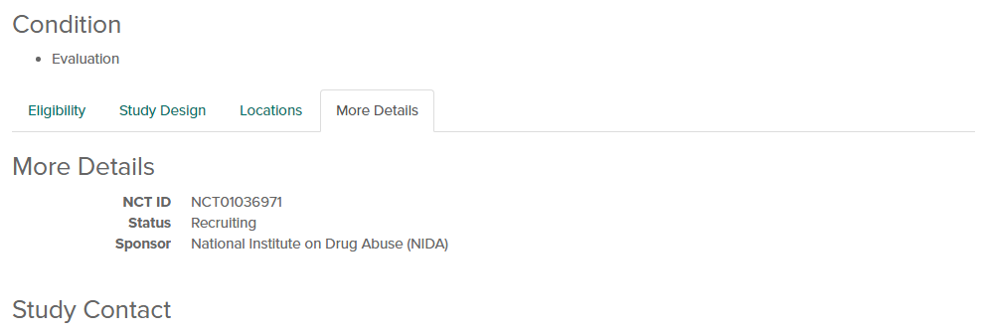
Notes:
There is a study contact listed in the “more details” section on the study specific page. This information is pulled from clinicaltrials.gov. Since this information is publically available to volunteers, we encourage you to list the contact information of an individual who would be able to speak with and help a volunteer to learn more or sign up for the study. If you would like to change any information for your study within the trials today search tool, please update your clinicaltrials.gov listing.

Slide 59
Questions?
email us at info@researchmatch.org
Notes:
Thank you for joining us! Please feel free to email us with questions.

