Slide 1

Innovation + New
Ventures Office
Licensing & New Venture Support

Slide 2








Katie Butcher
Master of Science in Law,
Pritzker School of Law
Northwestern University
Master of Business Administration,
Mendoza College of Business
University of Notre Dame
Bachelor of Business Administration,
Jack C. Massey College of Business
Belmont University
Director License Strategy & Business Development,
Innovation + New Ventures Office
Northwestern University
Viacom Media Networks
Global Rights Analyst, Business & Legal Affairs
Country Music Television
Senior Coordinator, Music & Media Licensing, Business & Legal Affairs
Broadcast Music, Inc.
Account Executive, General Licensing

Slide 3
Purposely Asked Questions
What are my goals?
How disruptive is my idea?
How soon can a commercial product be ready?
Who is going to buy my product?
What roles will I and my co-founders have?
How large is the market?
Who will own the company?
What are the company’s goals?
Cornell Startup Guide © Cornell University, Center for Technology Licensing

Slide 4
How are NU inventions licensed?

Slide 5
How are innovations licensed?
Exclusive Licenses
Non-Exclusive Licenses
Copyrights
Research materials
Software
Data
Materials Transfer Agreements

Slide 6
Who do we license to?

Slide 7
Who Gets a License?
Established Companies
Good product/market fit
Significant scale-up requirement
Lack of interest in entrepreneurship
Ready to go to market
Small or specialty market that cannot support a start-up
Start-ups
Opportunities to derisk
Expert involvement from scientific founders
Ability to attract capital
Sufficient market size to sustain a business

Slide 8
When is it time to start thinking about a license?

Slide 9
Reach out to INVO when…
Existing IP has commercial interest
Copyrights
Data
Current work has start-up implications
Start-up Formation
Northwestern IP is transitioning from academic research to commercial application

Slide 10

Third-Parties & IP
SPONSORS
COLLABORATORS
May have ownership / commercialization rights over IP that comes from sponsored projects
Can be logical partners for IP commercialization
Managed via an Interinstitutional Agreement (IIA)
Allows one institution to lead license negotiations
Disclosure to INVO is key to managing these relationships

Slide 11
How can I access IP?

Slide 12
Options & Licenses
Exclusive Option Agreement
  Time-limited
  Allows limited access to NU IP to test, study, build relationships, etc.
  Low cost
  Low commitment
  Low barrier to entry
Exclusive License Agreement
  Exclusive access to the IP for the term of the patent(s)
  Grants rights to manufacture & sell Licensed Products and sublicense IP
  Financial commitment
  Development milestones required

Slide 13
NU Start-Ups
 | Option | License
Company Formation | Company must be formed/formally incorporated.
Technology | Identify suitable, unencumbered technology and the relative maturity level required for the field.
Business Plan | Rough outline including potential market size. | Identification of potential market size, anticipated market share, proposed revenue model, timeline to market, funding plan including sources and anticipated amounts, regulatory hurdles, key competitors and potential customers.
Export Controls | Company has cleared the initial Export Control check
Funding Levels | Minimal – company should have a high-level idea of how to obtain initial funding for option extension fee + any foreign filings. | Full funding plan established including anticipated raises in the next one to three years that will fund required fees, R&D, personnel and IP costs.
Management | Plan to establish a management structure within the option term. | Established board with the power to hire/fire senior leadership within initial 6 months; at least one non-faculty senior leader/manager; identification of at least one external advisor.
Commercialization Stage | Required for company to practice the NU IP in question. Helpful for fundraising. | Required prior to sale or active marketing of any Licensed Products or Licensed Services inclusive of the NU IP.
NU Resources | InQbation Lab (for qualified start-ups), STTR grants, SBIR grants, EIR’s, FoundHer Program (for eligible founders), IM/IA managing patent prosecution

Slide 14
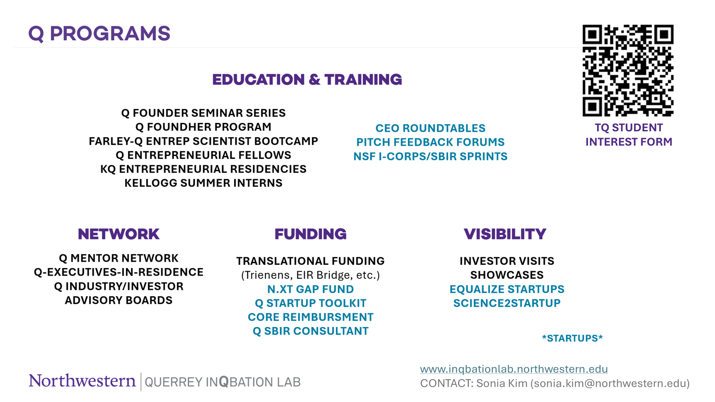

Slide 15
Outside Resources
STTR/SBIR Grants
Start-Up Competitions
Local Incubators & Accelerators

Slide 16
Questions?

Slide 17
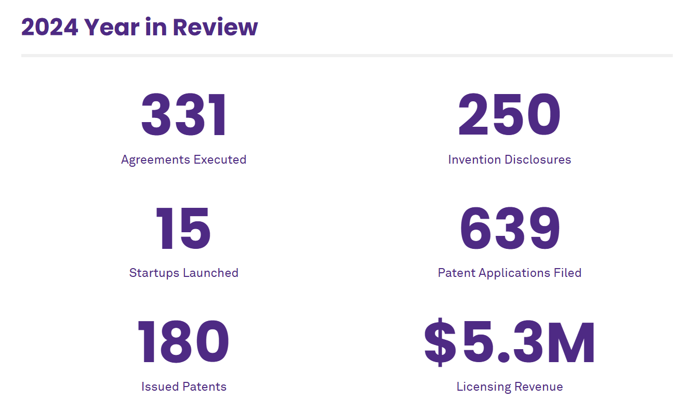
Chat with INVO
Licensing: Katie Butcher (Kathleen.butcher@northwestern.edu)
https://www.linkedin.com/in/katiebutcher
Invention Reporting / Patenting / Commercialization: Arjan Quist (arjan.quist@northwestern.edu)
https://www.linkedin.com/in/arjanquist

Slide 18
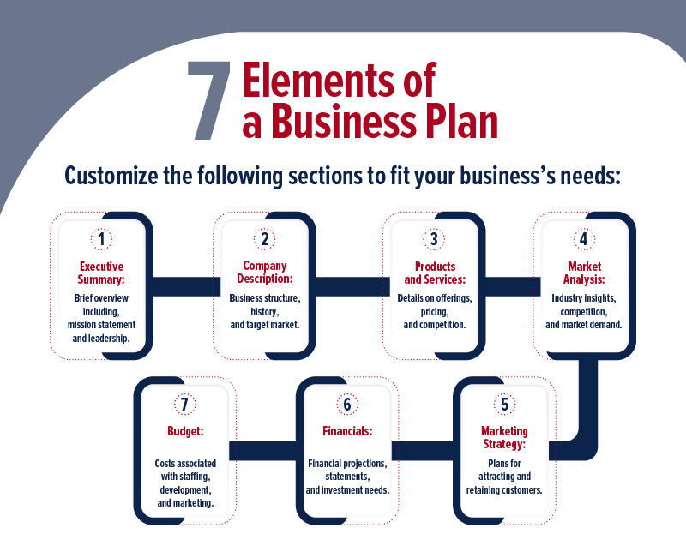
Source: The University of Arizona

Slide 19
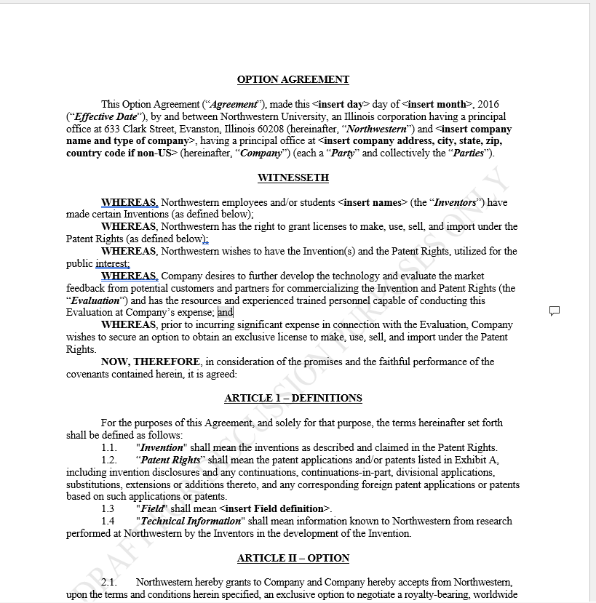
What’s in an Option?
A defined time period in which NU will NOT offer a license or option to other entities;
Short-term milestones;
Small financial commitment; and
A negotiation period in which the parties can discuss a full license.

Slide 20
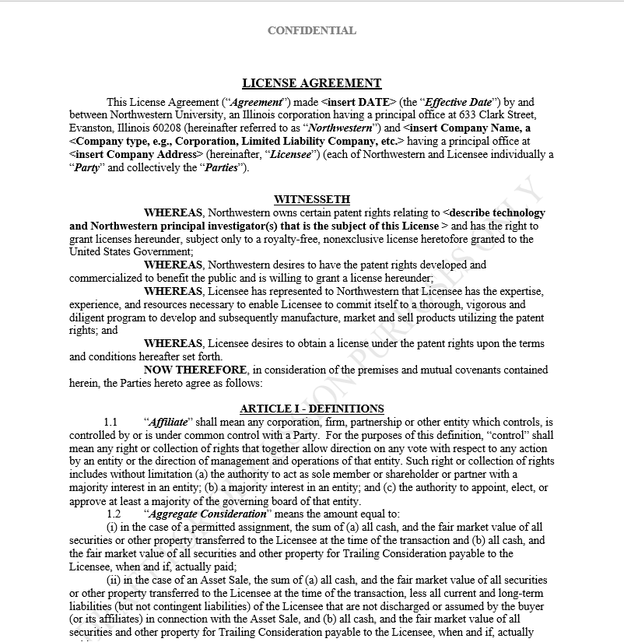
What’s in a License?
Exclusive rights to the NU IP
Financial Terms
  Patent Cost Reimbursement
  Revenue-sharing
    Royalties;
    Sublicense fees;
    Milestone fees;
    Exit fees and/or Equity
Long-term Milestones
Reporting Requirements
Manufacturing Requirements
Reps & Warranties
Insurance Requirements

Slide 21

What Goes Into a License?
Financial terms based on:
  Anticipated market
  Industry norms
  National averages
  Business plan
  Fundraising plan
  VC Feedback
Milestones based on:
  Business plan
  Industry norms
  Regulatory standards (if applicable)

Slide 22
Standard Terms
Indemnification, Representations & Warrants
Non-Commercial Research Rights
Government Rights
US Domestic Manufacturing Requirements
Insurance Requirements
Export Control Requirements
Assignment Rights

Slide 23
Other Terms to Think About
Definitions
Sublicensing Rights
Reporting Requirements
Audit Rights
Patent Expense Reimbursements
Notices
Term and Termination
Patent Prosecution
Confidentiality
Related Rights/Improvements

